Slide 1
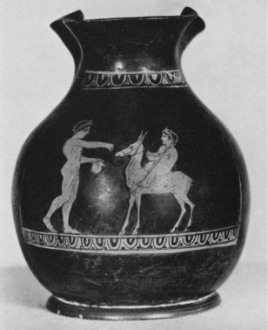
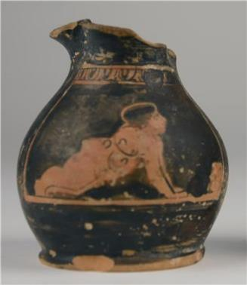
Children and Choes

Slide 2
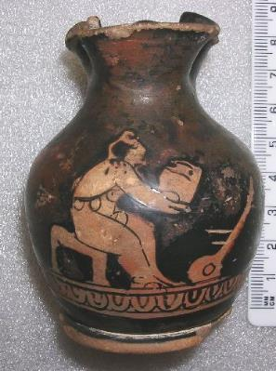
Chous
Pronounced: ‘Koo-s’

Slide 3
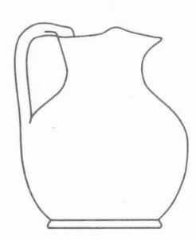
Choes
Special oinochoe (jug)
Squat stature (‘pot-bellied’)
Trefoil mouth
Choes for children
Small / ‘miniature’
5-20cm
1000+ found
Especially popular 450 to 400 BC

Slide 4
Iconography
What pictures do we see on choes?

Slide 5
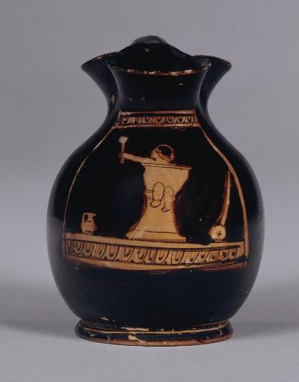
Babies

Slide 6
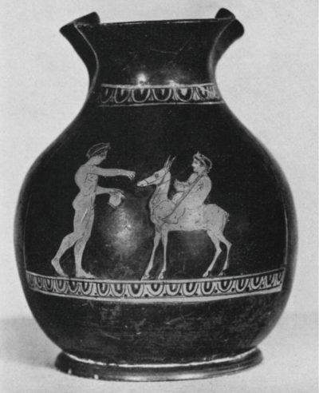
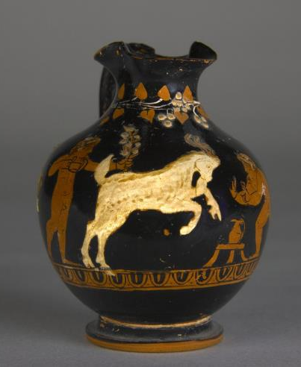
Children with Animals

Slide 7
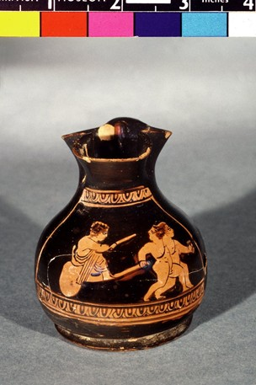
Children with Toys: Carts

Slide 8
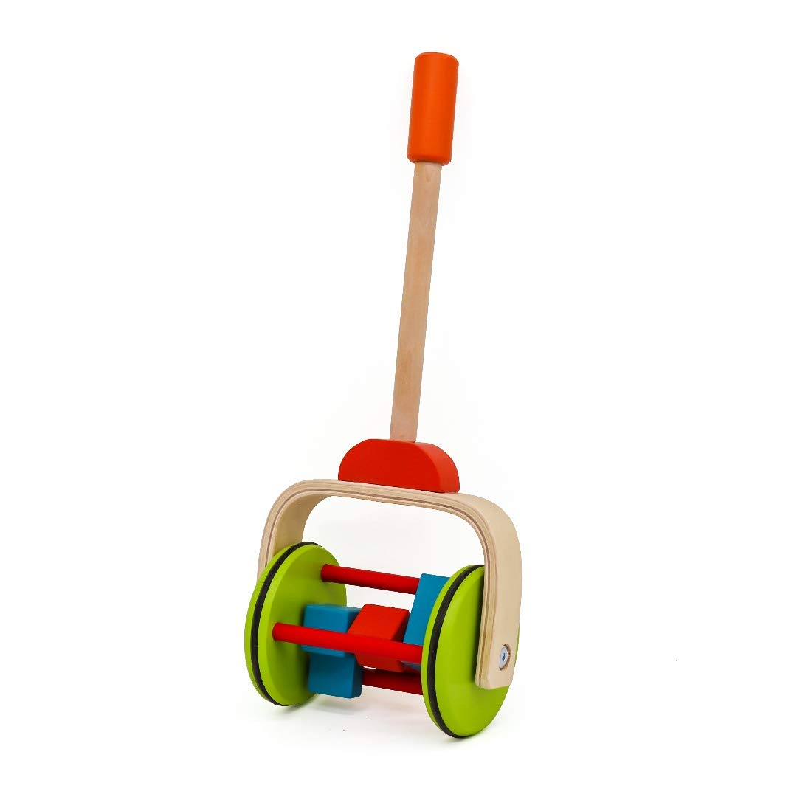
Children with Toys: Rollers

Slide 9
Children with Cakes

Slide 10
Children Wearing Amulets

Slide 11
Function
What were choes used for?

Slide 12
Grave Goods
Anthesteria
Flower festival
Celebrating new wine
Dionysus
Day 2: Children drink wine
Toys
Little jugs for children
To use?
To play with?

Slide 13
